Slide 1

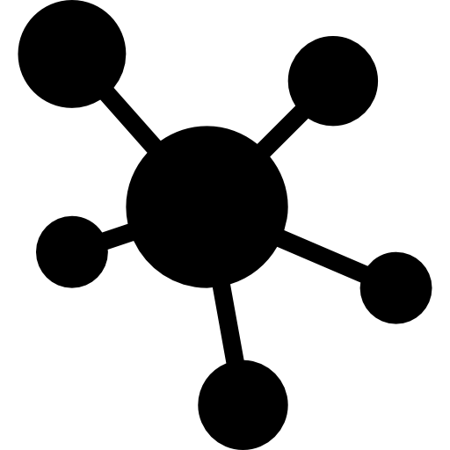
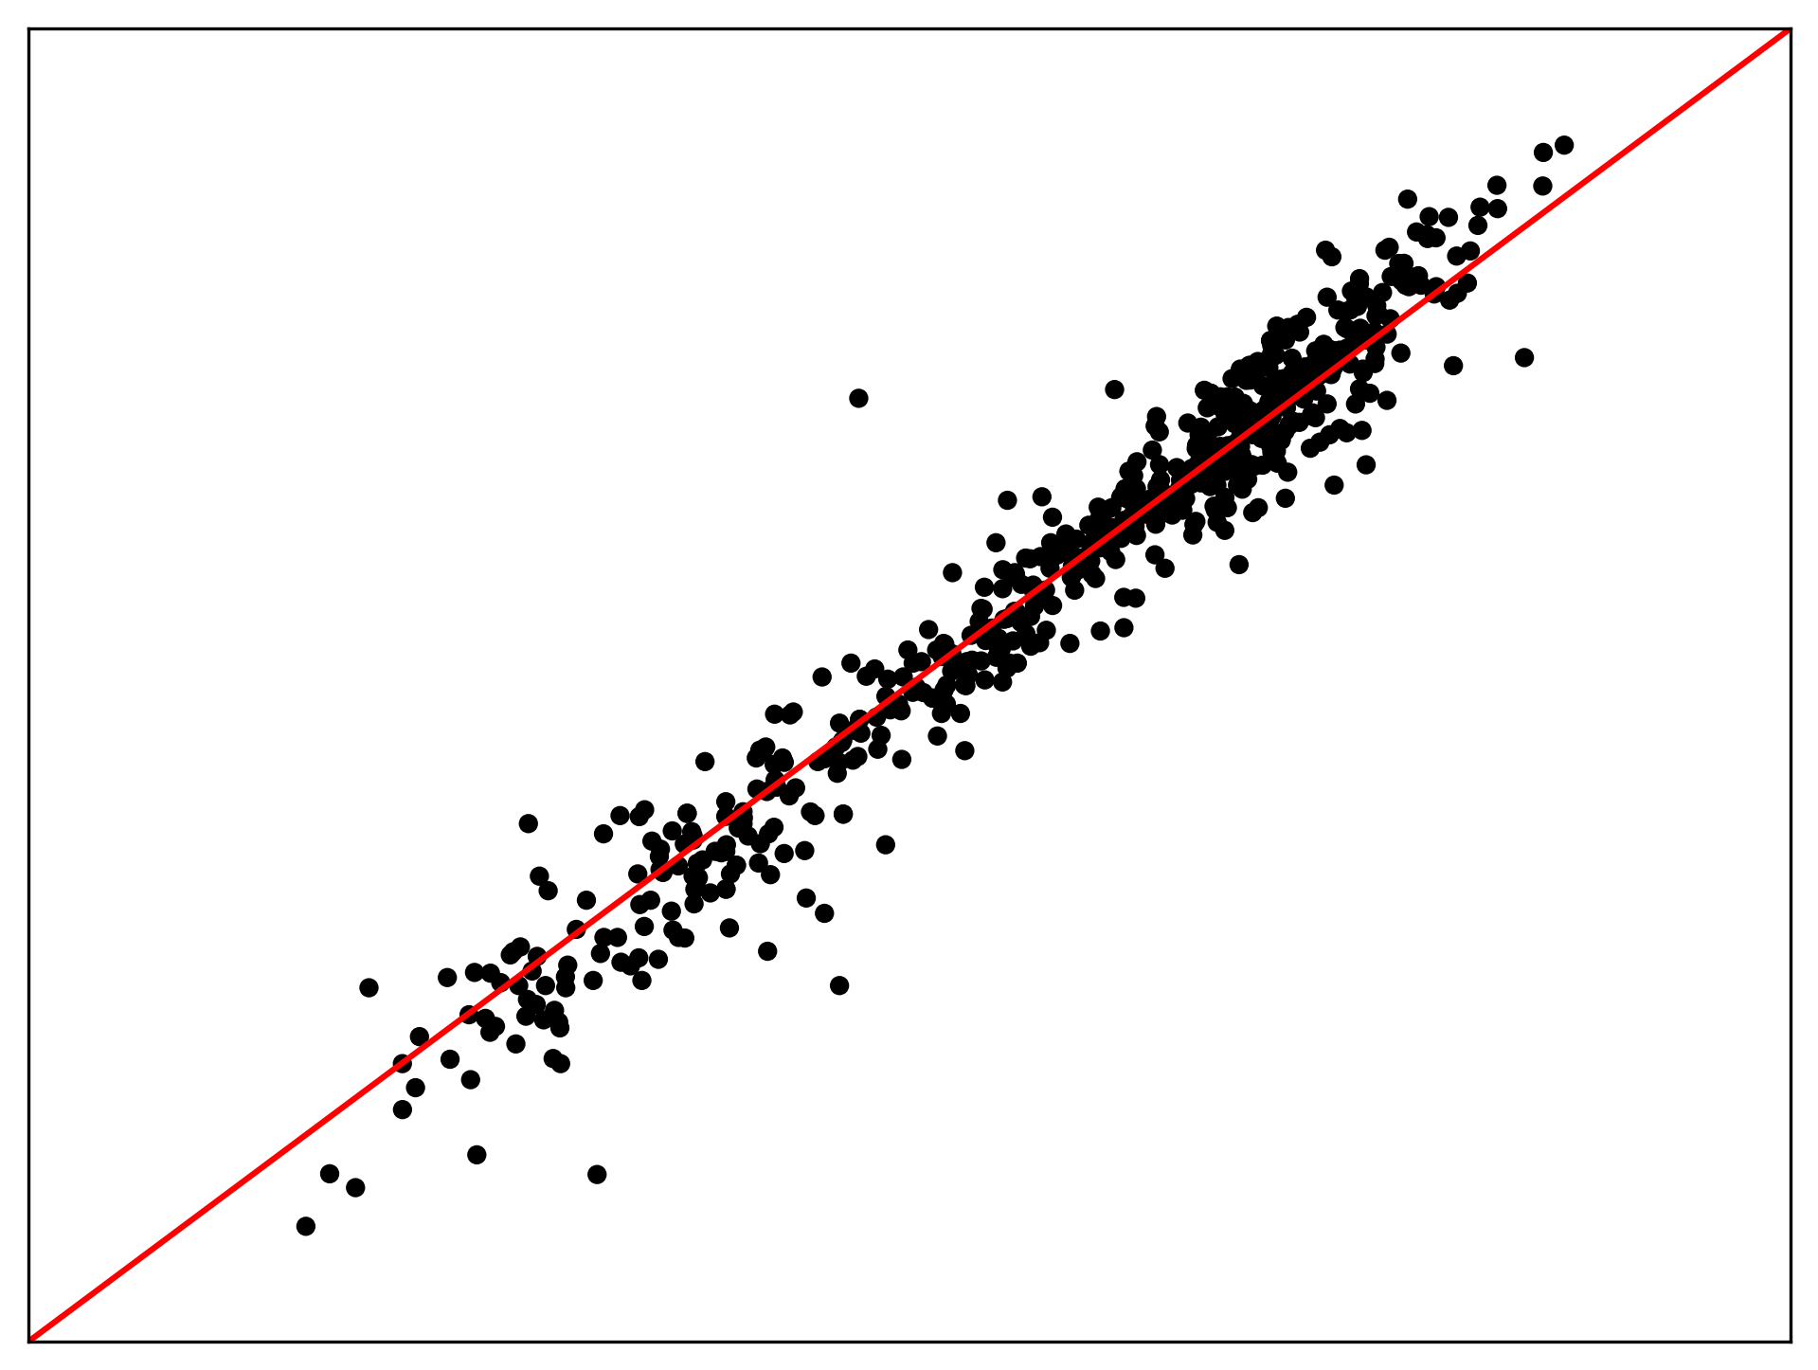

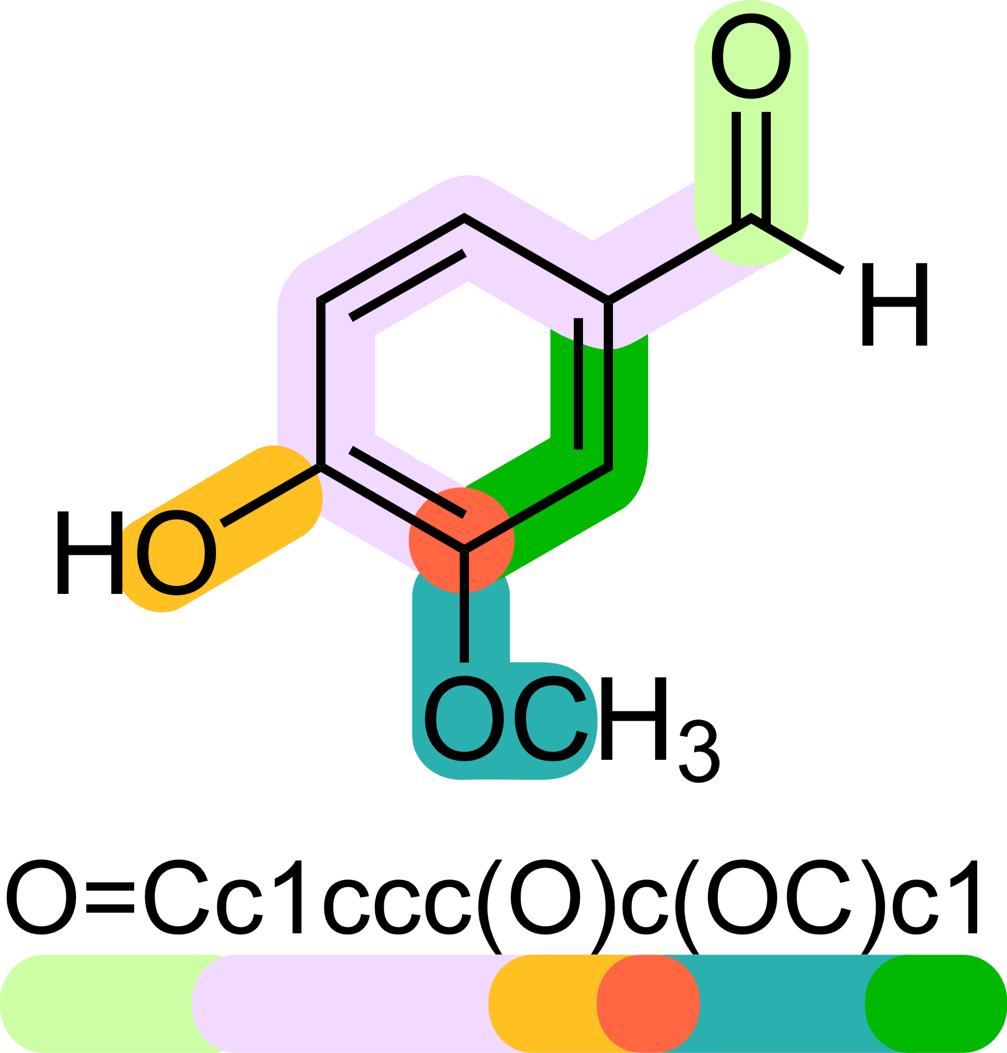
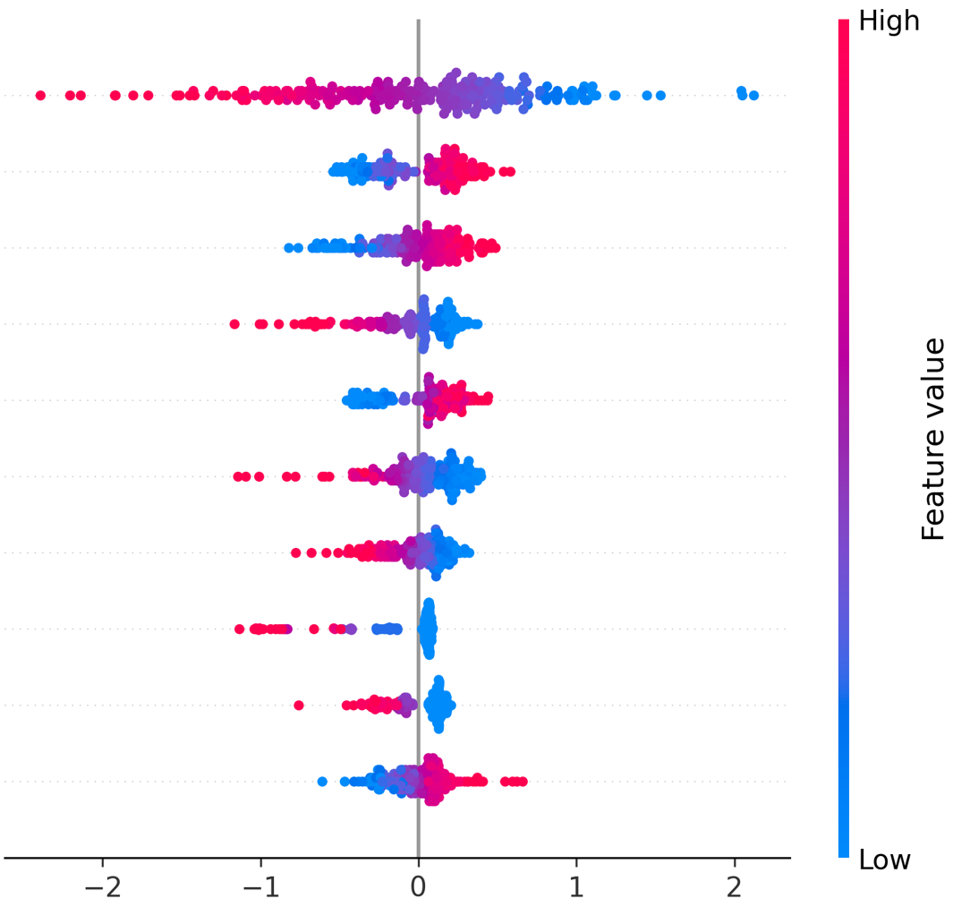

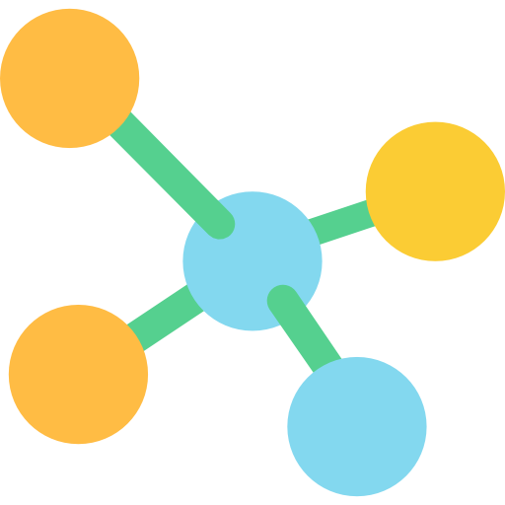


Stage #1.
Structural & Descriptor extraction
Stage #2. Multimodal Fusion
Stage #3.
Predictive &
Explanatory outputs
Graph modality
Descriptor modality
NOCount
...
Molwt
TPSA
Chi2v
Graph Structure
Prediction
Capturing Atomic–bond relational patterns
Enforcing parsimonious variable selection
Kronecker-product
Descriptors using RDkit
Molwt
Kappa2
NOCount
...
fr_bicycle
...
TPSA
Chi2v
Modeling sparse cross-modal interactions
Interpretation

